Slide 1
Machine Learning HW #3
Javier Salazar 1001144647

Slide 2
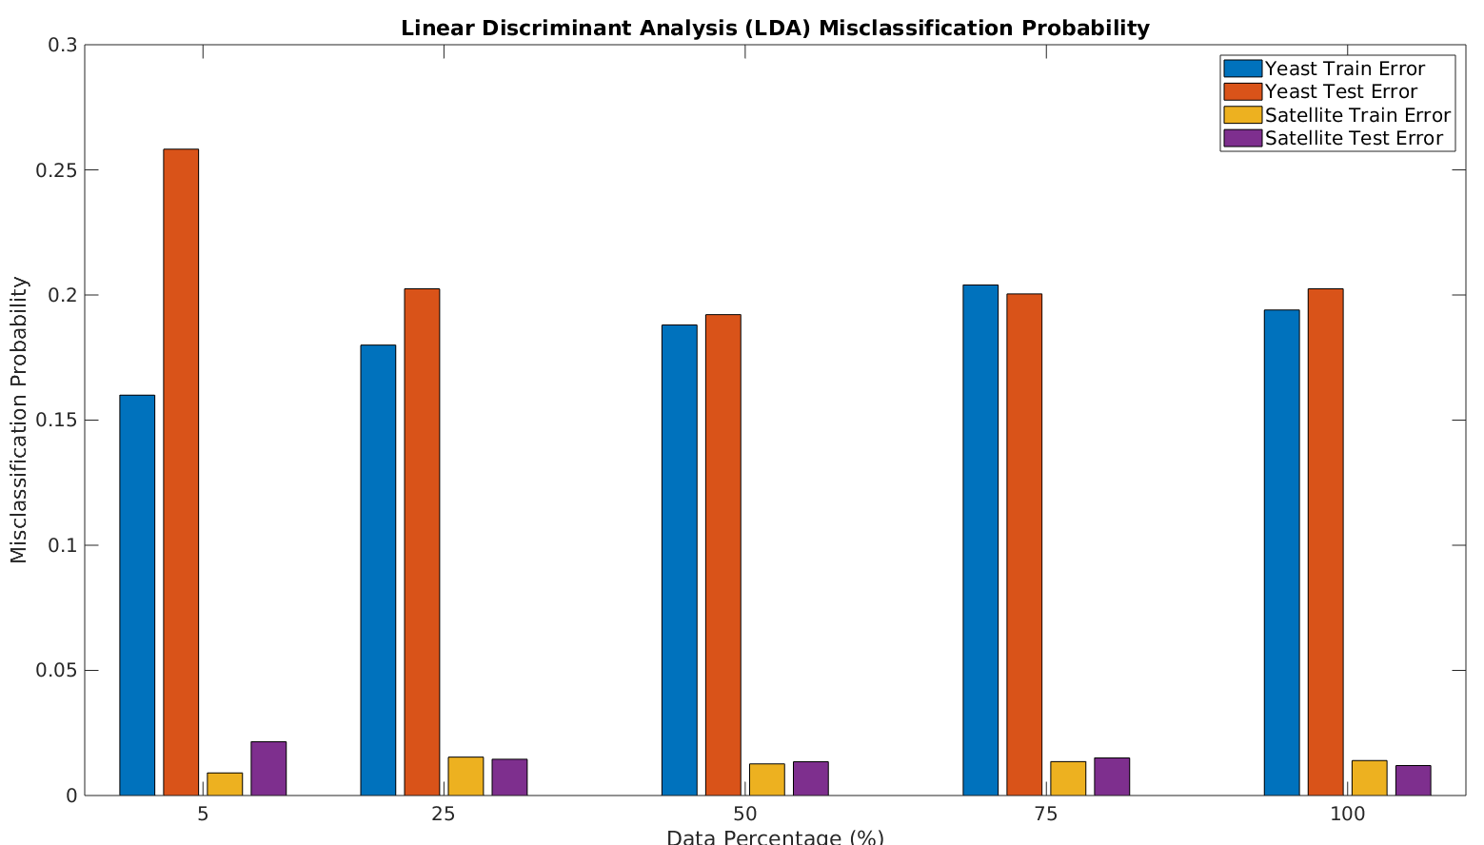
Problem #1 (LDA)

Slide 3
LDA Analysis
Very small lambda 1e-12 is used to prevent singular covariance matrix when using 5% of training data
Results stabilize after using 50% of training data or around 500 data points
Satellite training data consists of 5 times the amount of points as Yeast dataset therefore we expect lower misclassification probability

Slide 4
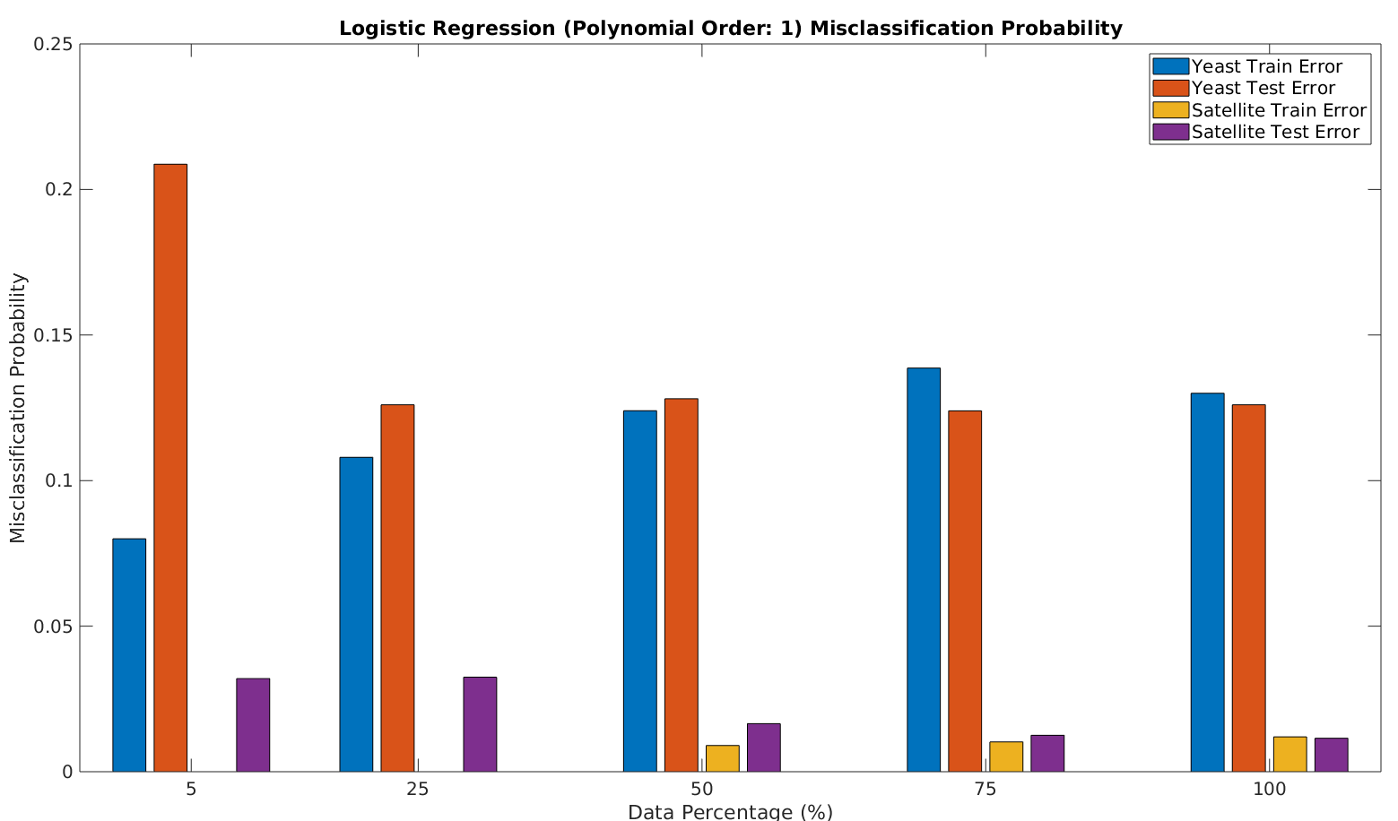
Logistic Regression – Order: 1

Slide 5
Logistic Regression – Order 1 - Analysis
Lambda 0.1 used to ensure convergence in Newton-Ralphson method
Stable results after 50% training data used except for numerical instability issue seen at 75% training data where training error slightly bigger than test error
Model fits training data perfectly when we have low amount of training data but will still have testing error as expected

Slide 6
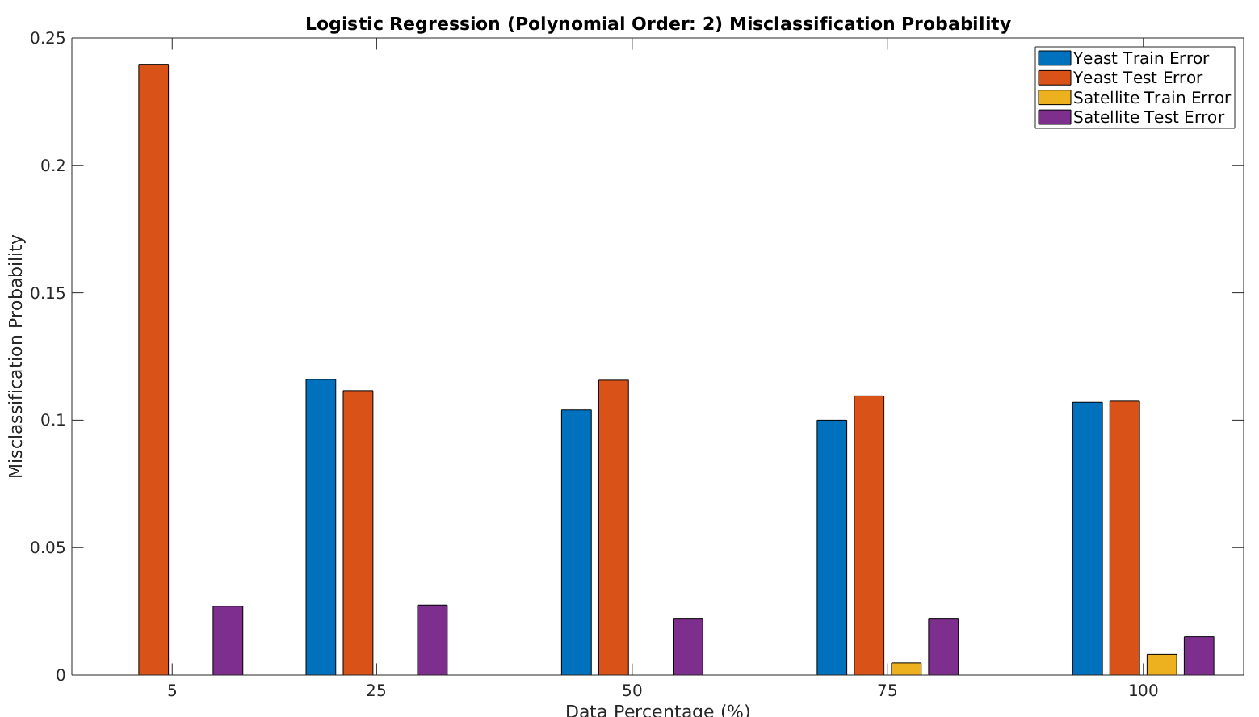
Logistic Regression – Order: 2

Slide 7
Logistic Regression – Order 2 - Analysis
Order 2 does an even better job at fitting training data when lower amount of data is used but will still have test error
Misclassification starts to stabilize after 25% of training data is used
Lambda 0.1 used to prevent singular matrix during Newton-Ralphson method

Slide 8
Overall Analysis
Method | Training Misclassification (Yeast / Satellite) | Testing Misclassification (Yeast / Satellite)
LDA – 100% Data | 0.194 / 0.01398 | 0.2025 / 0.012
Logistic (Order 1) – 100% Data | 0.13 / 0.01195 | 0.126 / 0.0115
Logistic (Order 2) – 100% Data | 0.107 / 0.008117 | 0.1074 / 0.015
From above, lowest training error is using order 2 LR followed by order 1 LR and then LDA. This is exactly what we expect to see for both datasets. For the testing error, we get the lowest on order 1 LR surprisingly. Order 2 LR performed the worst (relatively). However, as seen from the bar graphs, order 2 LR was better at lowering testing error when there was less training data (i.e. 25% 50% 75%) relative to order 1 LR.

